Slide 1

Wifi: LoblawDigital
Password:
Blaa

Slide 2

Presented to you by
&
NSCoderTO

Slide 3
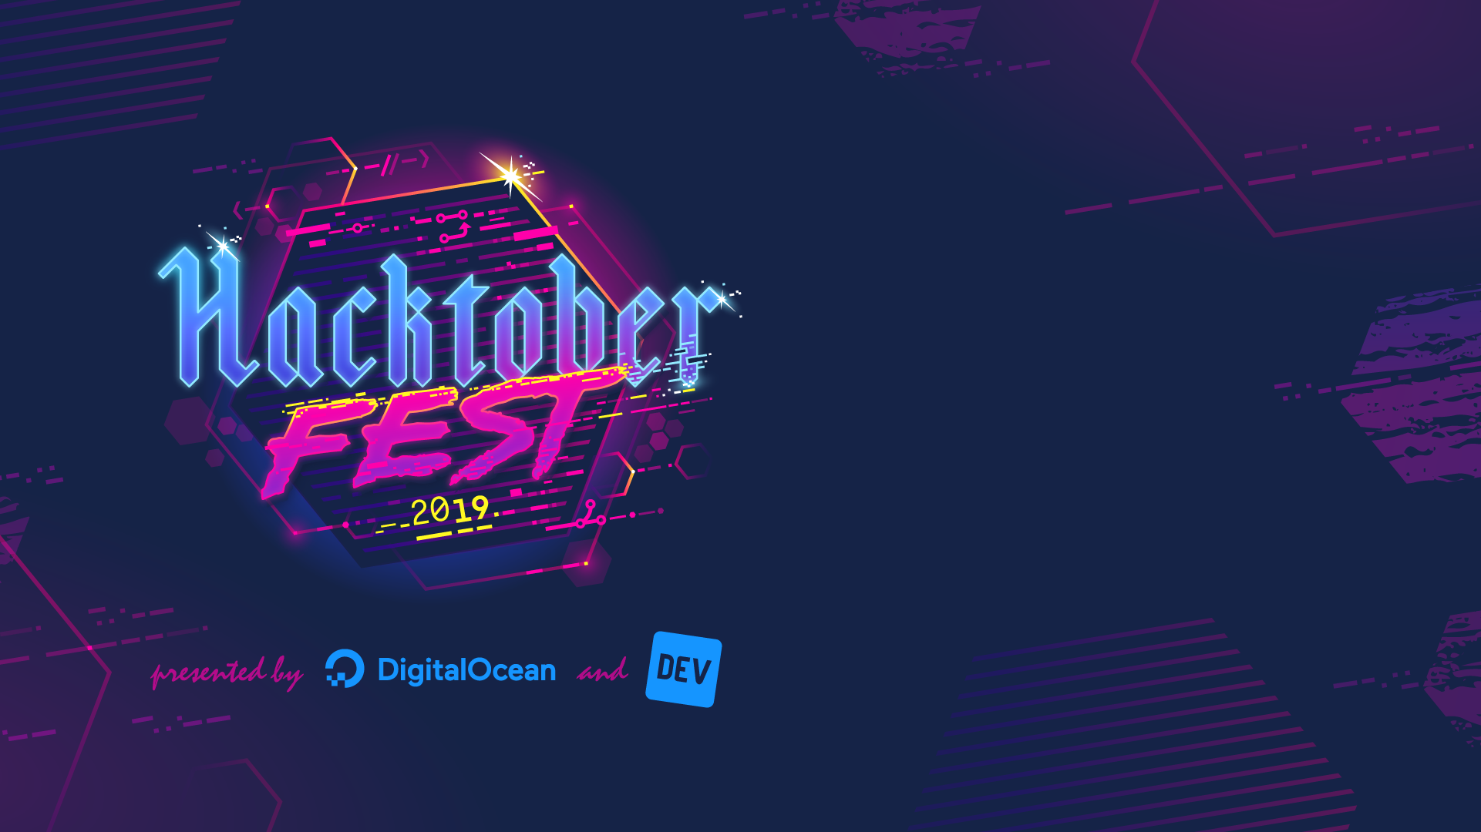
Loblaw Digital & NSCoderTO
What is Hacktoberfest?
🤔
Hacktoberfest is a global month-long celebration of open source software. It’s open to everyone who is passionate about open source, it’s growth, and making positive contributions to it’s community.

Slide 4
Loblaw Digital & NSCoderTO
Who can participate?
Whether you are an experienced developer, student learning code, or not in the industry at all.
People of all ages and skill levels are encouraged to participate.

Slide 5
Loblaw Digital & NSCoderTO
How do I get started?
Create a GitHub account if you don’t already have one → https://github.com/join
Then register at → hacktoberfest.digitalocean.com
Last, but not least submit at least four PRs to any public GitHub repository

Slide 6
Loblaw Digital & NSCoderTO
Are you maintaining a repo?
Create issues or label existing ones with Hacktoberfest on your GitHub projects to help new contributors know what to work on. Tag any spam or irrelevant PRs with the invalid label to disqualify them.

Slide 7
Loblaw Digital & NSCoderTO
Emm, that’s all you’ve got?
More details on → hacktoberfest.digitalocean.com
Useful links with details, tutorials and more on my public repo on Github →
https://github.com/MargarytaChepiga/Hacktoberfest19

Slide 8
Loblaw Digital & NSCoderTO
“Why should one invest in Open Source Software”
Volodymyr is a research assistant at Centre for Development of Open Technology at Seneca College. He will talk about the value of Open Source Software (OSS) and the reasons why you might be interested in investing your resources into OSS.

Slide 9
Loblaw Digital & NSCoderTO
“A little goes a long way - Tips and Ideas for Contributing”
Kyle will talk about different ways to get more involved in open source based on his personal experiences making small contributions to projects.

